Slide 1


[Title]

Slide 2


Today's agenda
Project recap
Problem
The Analytics team
Process
Insights
Summary

Slide 3

Founders: Social Buzz was started in 2008 by ex-engineers from a large social media company, focusing on anonymous user interactions with content.
Growth: They have 500 million active users monthly and handle over 100,000 pieces of content daily.
Need: Seeking external expertise for IPO preparation, scaling management, and learning big data best practices.
Project Deliverables: Audit big data practices, provide IPO recommendations, and analyze top 5 content categories by popularity.
Project Recap

Slide 4

Problem
The problem was to analyze the content categories to identify and highlight the top 5 categories with the largest aggregate popularity

Slide 5
Andrew Fleming (Chief Technical Architect)
The Analytics team
Marcus Rompton (Senior Principle)
Gaurav Rawat (Data Analyst)

Slide 6
Process
1
Data Understanding
2
Data Cleaning
3
Data Modelling
4
Data Analysis
5
Uncover Insights

Slide 7

Insights
Top 5 categories are:
Animals : 74965
Science : 64756
Healthy eating : 6679
Technology : 52511
Food : 57436
There are 16 unique categories.
Reactions to most popular categories:
Animals 1897
Science 1796
Healthy eating 1717
Technology 1698
Food 1699
Animals , education, cooking, dogs, travel, healthy eating, veganism, science, fitness, food, culture, studying, technology, tennis, public speaking, soccer

Slide 8
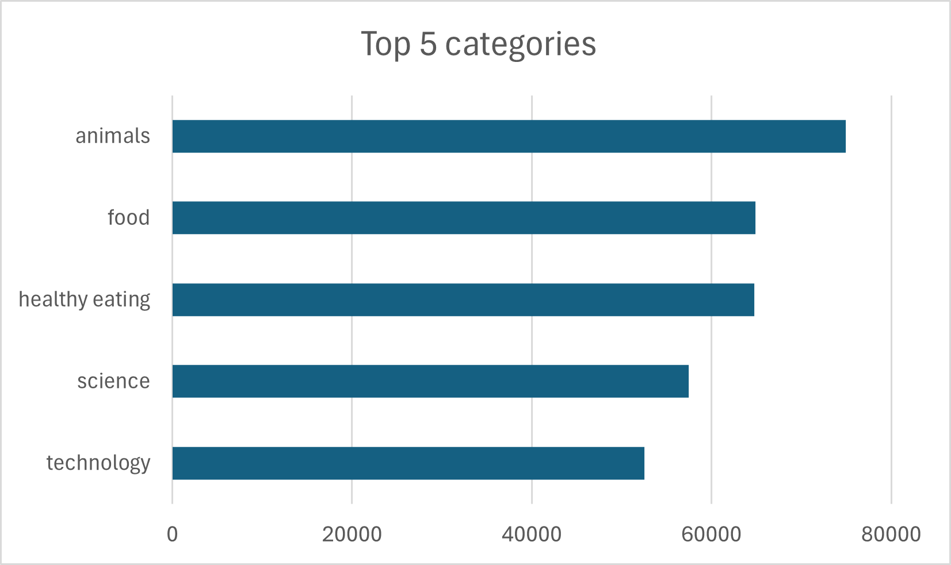
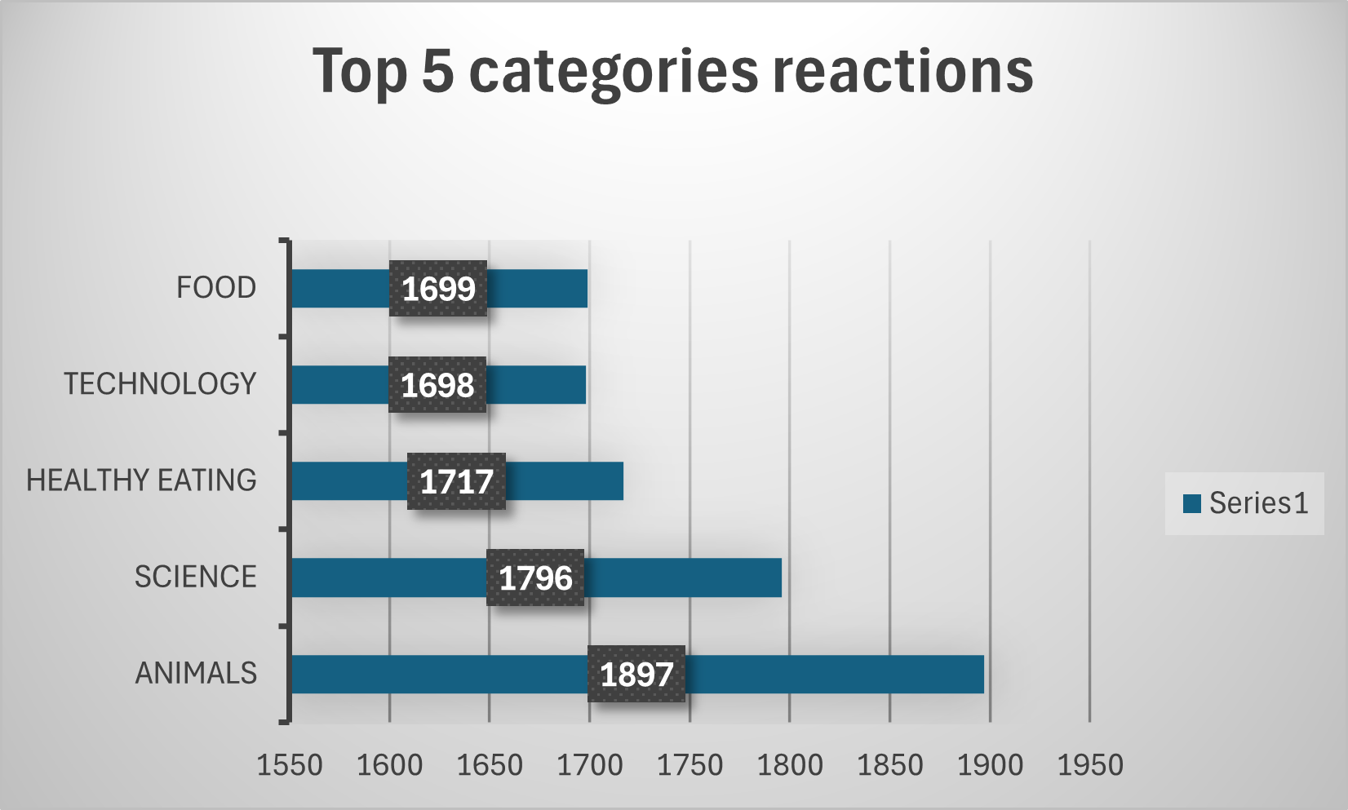

Slide 9
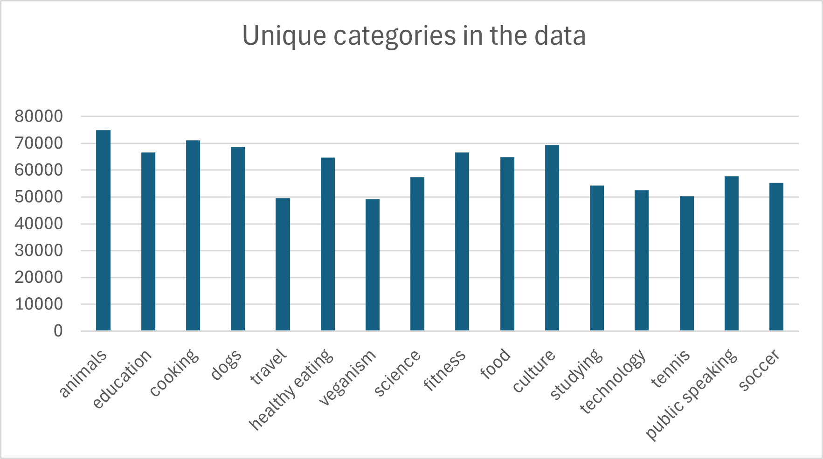
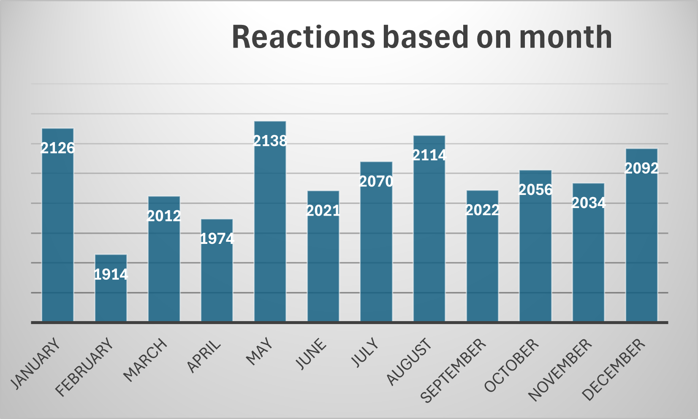

Slide 10

By data analysis it is known that Animal and Science gets most reactions.
It is seen that may has most reaction in a month so people are more active in summer time because they are mostly inside rooms.
Summary

Slide 11
Thank you!
ANY QUESTIONS?

